Slide 1
2
0
1
8
Blockchain Intro.
A blockchain is a decentralized, distributed and public digital ledger that is used to record transactions across many computers so that the record cannot be altered retroactively without the alteration of all subsequent blocks and the consensus of the network.

Slide 2
1
什么是区块链
What the blockchain realy is?
2
区块链技术
Technology of blockchain
目 录
CONTENTS
3
区块链应用
Usage of blockchain
4
入门区块链
Get into blockchain

Slide 3
01
什么是区块链
What the blockchain realy is?
Part One

Slide 4

什么是区块链
What the blockchain realy is?
distributed(Block + Chain)
分布式计算机系统（分布式帐本）
去除第三方依赖（去中心化）、无需信任

Slide 5
什么是区块链
What the blockchain realy is?
请输入您的标题
Please enter your content here, can be used to paste by copying your text and choose to keep only text. Please enter your content here, can be used to paste by copying your text and choose to keep only text. Please enter your content here, can be used to paste by copying your text and choose to keep only text.

Slide 6
02
区块链技术
Technology of blockchain
Part Two

Slide 7
区块链技术
Technology of blockchain.
密码学
Cryptography is about constructing and analyzing protocols that prevent third parties or the public from reading private messages.
分布式系统
A distributed system is a system whose components are located on different networked computers.
Cryptography
Protocol
communication protocol is a system of rules that allow two or more entities of a communications system to transmit information via any kind of variation of a physical quantity.
Distributed
Game
网络协议
博弈论
Game theory is the study of mathematical models of strategic interaction between rational decision-makers.

Slide 8
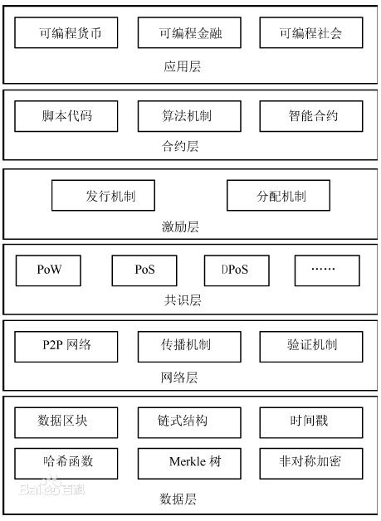

区块链技术
Technology of blockchain.
站在巨人的肩膀

Slide 9
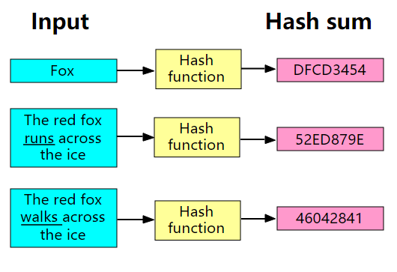
区块链技术
Technology of blockchain.
哈希算法（散列函数）
散列函数（英语：Hash function）又称散列算法、哈希函数，是一种从任何一种数据中创建小的数字“指纹”的方法。散列函数把消息或数据压缩成摘要，使得数据量变小，将数据的格式固定下来。该函数将数据打乱混合，重新创建一个叫做散列值（hash values，hash codes，hash sums，或hashes）的指纹。

Slide 10
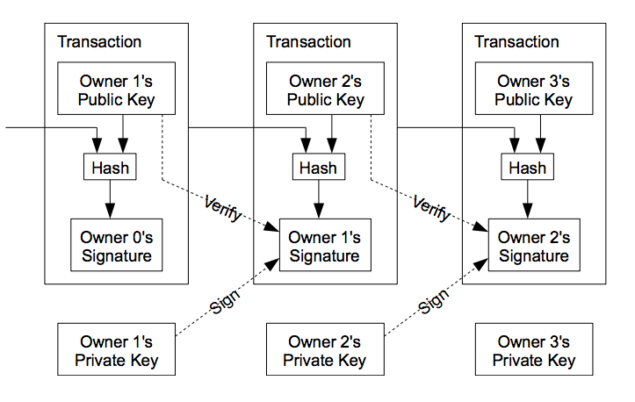
区块链技术
Technology of blockchain.
挖矿
计算一个数字，第一个计算出该数字的奖励x个币
每个区块都包含了上个区块的校验信息（摘要），修改一个区块需要同时修改全部区块（如图）
两个矿工同时计算出该数字，分叉，链长的保留，链短的舍弃.
51%攻击

Slide 11
区块链技术
Technology of blockchain.
共识机制
PoW
DPoS
Proof of Work，工作量证明.
Delegated Proof of Stake，委任权益证明.
PoS
PBFT
Proof of Stake，股权证明.
Practical Byzantine Fault Tolerance，拜占庭容错算法.

Slide 12
03
区块链应用
Usage of blockchain.
Part Three

Slide 13
区块链应用
Usage of blockchain.
智能合约应用平台
Smart Contract
Ethereum（以太坊/ETH）、EOS、NEO、Bytom（比原链/BTM）、Aeternity（AE）、BitShares（比特股/BTS）……
加密货币
Cryptocurrency
BitCoin（比特币/BTC）、Ripple（瑞波币/XRP）、Litecoin（莱特币/LTC）、Bitcoin Cash（比特现金/BCH）、Tether（USDT）……
代币
Token
ORS

Slide 14
04
入门区块链
Get into blockchain.
Part Four

Slide 15
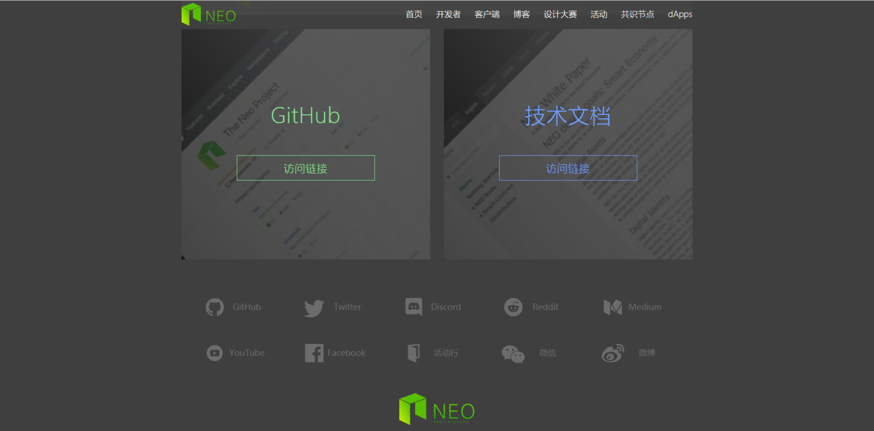
入门区块链
Get into blockchain.
市场价值，交易所（CoinMarketCap、Binance、OKEx）
官网 >> 白皮书 >> GitHub >> 技术文档 >> ttfm（社群） + google

Slide 16
区块链应用
Usage of blockchain.
区块链中文媒体&论坛
BBS & Media
8bit、钛媒体、金色财经、铅笔、非小号、火星财经……

Slide 17


Slide 18
01
请输入您的标题
Please enter your content here, can be used to paste by copying your text and choose to keep only text.
Part One

Slide 19
请输入您的标题
Experience as your reference, prudence as your brother.
请输入您的标题
Please enter your content here, can be used to paste by copying your text and choose to keep only text.
3,456￥
Please enter your content here
Please enter your content here, can be used to paste by copying your text and choose to keep only text.
Please enter your content here, can be used to paste by copying your text and choose to keep only text. Please enter your content here, can be used to paste by copying your text and choose to keep only text.

Slide 20
请输入您的标题
Experience as your reference, prudence as your brother.
请输入您的标题
Please enter your content here, can be used to paste by copying your text and choose to keep only text. Please enter your content here, can be used to paste by copying your text and choose to keep only text. Please enter your content here, can be used to paste by copying your text and choose to keep only text.
请输入标题
请输入标题
请输入标题
请输入标题

Slide 21
请输入您的标题
Experience as your reference, prudence as your brother.
请输入您的标题
请输入您的标题
Please enter your content here, can be used to paste by copying your text and choose to keep only text.
Please enter your content here, can be used to paste by copying your text and choose to keep only text.
请输入您的标题
请输入您的标题
Please enter your content here, can be used to paste by copying your text and choose to keep only text.
Photoshop Cs6
Please enter your content here, can be used to paste by copying your text and choose to keep only text.
请输入您的标题
请输入您的标题
Please enter your content here, can be used to paste by copying your text and choose to keep only text.
Please enter your content here, can be used to paste by copying your text and choose to keep only text.

Slide 22
请输入您的标题
Experience as your reference, prudence as your brother.
请输入您的标题
Please enter your content here, can be used to paste by copying your text and choose to keep only text. Please enter your content here, can be used to paste by copying your text and choose to keep only text.

Slide 23

请输入您的标题
Experience as your reference, prudence as your brother.
请输入您的标题
Please enter your content here, can be used to paste by copying your text and choose to keep only text.
Windows 10
Please enter your content here, can be used to paste by copying your text and choose to keep only text.
37.5%
Please enter your content here, can be used to paste by copying your text and choose to keep only text. Please enter your content here, can be used to paste by copying your text and choose to keep only text.

Slide 24
02
请输入您的标题
Please enter your content here, can be used to paste by copying your text and choose to keep only text.
Part Two

Slide 25
请输入您的标题
Experience as your reference, prudence as your brother.
请输入标题
请输入标题
请输入标题
请输入标题
Please enter your content here, can be used to paste by copying your text and choose to keep only text.
Please enter your content here, can be used to paste by copying your text and choose to keep only text.
Please enter your content here, can be used to paste by copying your text and choose to keep only text.
Please enter your content here, can be used to paste by copying your text and choose to keep only text.

Slide 26


请输入您的标题
Experience as your reference, prudence as your brother.
Please enter your content here, can be used to paste by copying your text and choose to keep only text. Please enter your content here
Please enter your content here, can be used to paste by copying your text and choose to keep only text.
Lebron James
Allen Iverson
Experience as your reference, prudence.
Your and will brother prudence a as.
23
21

Slide 27
请输入您的标题
Experience as your reference, prudence as your brother.
请输入标题
Please enter your content here, can be used to paste by copying your text
请输入标题
Please enter your content here, can be used to paste by copying your text
04
请输入标题
Please enter your content here, can be used to paste by copying your text
请输入标题
03
Please enter your content here, can be used to paste by copying your text
02
01

Slide 28
请输入您的标题
Experience as your reference, prudence as your brother.
请输入您的标题
Please enter your content here, can be used to paste by copying your text and choose to keep only text.
请输入您的标题
请输入您的标题
Please enter your content here, can be used to paste by copying your text and choose to keep only text.
请输入您的标题
Please enter your content here, can be used to paste by copying your text and choose to keep only text.

Slide 29
请输入您的标题
Experience as your reference, prudence as your brother.
请输入您的标题
2
0
1
7
2
0
1
8
Please enter your content here, can be used to paste by copying your text and choose to keep only text.
65.2%
74.8%
请输入您的标题
Please enter your content here, can be used to paste by copying your text and choose to keep only text.

Slide 30
03
请输入您的标题
Please enter your content here, can be used to paste by copying your text and choose to keep only text.
Part Three

Slide 31
请输入您的标题
Experience as your reference, prudence as your brother.
请输入您的标题
Please enter your content here, can be used to paste by copying your text and choose to keep only text.
请输入您的标题
Please enter your content here, can be used to paste by copying your text and choose to keep only text.
Weakness
Threats
Please enter your content here, can be used to paste by copying your text and choose to keep only text.
Superiority
Opportunity
请输入您的标题
请输入您的标题
Please enter your content here, can be used to paste by copying your text and choose to keep only text.

Slide 32

请输入您的标题
Experience as your reference, prudence as your brother.
请输入您的标题
Please enter your content here, can be used to paste by copying your text and choose to keep only text. Please enter your content here, can be used to paste by copying your text and choose to keep only text.
Please enter your content here, can be used to paste by copying your text and choose to keep only text. Please enter your content here
4,465$
78%
请输入标题
请输入标题

Slide 33
请输入您的标题
Experience as your reference, prudence as your brother.
请输入您的标题
请输入您的标题
Please enter your content here, can be used to paste by copying your text and choose to keep only text.
Please enter your content here, can be used to paste by copying your text and choose to keep only text.
请输入您的标题
请输入您的标题
Please enter your content here, can be used to paste by copying your text and choose to keep only text.
Please enter your content here, can be used to paste by copying your text and choose to keep only text.

Slide 34
请输入您的标题
Experience as your reference, prudence as your brother.
78.6%
请输入您的标题
请输入您的标题
请输入您的标题
Please enter your content here, can be used to paste by copying your text and choose to keep only text.
Please enter your content here, can be used to paste by copying your text and choose to keep only text.
Please enter your content here, can be used to paste by copying your text and choose to keep only text.

Slide 35
请输入您的标题
Experience as your reference, prudence as your brother.
请输入您的标题
Please enter your content here, can be used to paste by copying your text and choose to keep only text.
Please enter your content here, can be used to paste by copying your text and choose to keep only text.
Please enter your content here, can be used to paste by copying your text and choose to keep only text.
请输入您的标题
Please enter your content here, can be used to paste by copying your text and choose to keep only text. Please enter your content here, can be used to paste by copying your text and choose to keep only text.

Slide 36
04
请输入您的标题
Please enter your content here, can be used to paste by copying your text and choose to keep only text.
Part Four

Slide 37
01
请输入您的标题
Experience as your reference, prudence as your brother.
请输入您的标题
请输入您的标题
Please enter your content here, can be used to paste by copying your text and choose to keep only text. Please enter your content here, can be used to paste by copying your text and choose to keep only text.
请输入您的标题
请输入您的标题
Please enter your content here, can be used to paste by copying your text and choose to keep only text. Please enter your content here, can be used to paste by copying your text and choose to keep only text.
请输入您的标题

Slide 38
请输入您的标题
Experience as your reference, prudence as your brother.
78.6%
Step One
Step Two
Step Three
请输入您的标题
请输入您的标题
Please enter your content here, can be used to paste by copying your text and choose to keep only text. Please enter your content here, can be used to paste by copying your text and choose to keep only text.
Please enter your content here, can be used to paste by copying your text and choose to keep only text. Please enter your content here, can be used to paste by copying your text and choose to keep only text.

Slide 39
请输入您的标题
Experience as your reference, prudence as your brother.
18.2%
33.4%
56%
North America
Please enter your content here, can be used to paste by copying your text and choose to keep only text.
China
Please enter your content here, can be used to paste by copying your text and choose to keep only text.
European
Please enter your content here, can be used to paste by copying your text and choose to keep only text.

Slide 40
请输入您的标题
Experience as your reference, prudence as your brother.
辽宁
35.6%
Please enter your content here, can be used to paste by copying your text and choose to keep only text.
山东
44.1%
Please enter your content here, can be used to paste by copying your text and choose to keep only text.
福建
16.8%
Please enter your content here, can be used to paste by copying your text and choose to keep only text.
广州
61.8%
Please enter your content here, can be used to paste by copying your text and choose to keep only text.

Slide 41
感谢观看

